Slide 1
Door Production Manager
GUI Mockup
By: Team No Name Yet
Eric Ray, Ervin Rodriguez, Miguel Cardenas, Richard Salcedo, Stefan Marchand

Slide 2

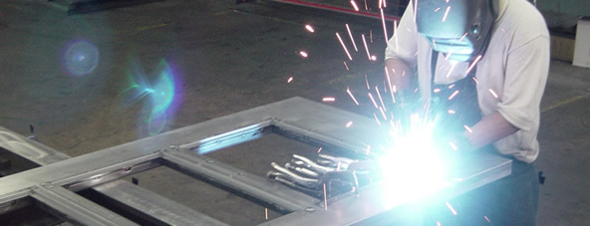
Door Production Manager
DEANSTEEL MANUFACTURING COMPANY
Username:
Password:
LOGIN
Login Page - When user runs Application, Login Page is the first page they will see. Enter username and PW, click Login.

Slide 3
Door Production Manager
DEANSTEEL MANUFACTURING COMPANY
Inventory
Orders
Quote
Users
Report
LOGOUT
Quickstart Links:
- Start a new Quote!
- Check Inventory
- Check unfinished Orders
SEARCH
Landing Page - The page after successful login. Mostly a black page with quick links on the side menu panel. All pages will always contain search bar.

Slide 4
Door Production Manager
DEANSTEEL MANUFACTURING COMPANY
Inventory
Orders
Quote
Users
Report
LOGOUT
+ Parts
Item ID: 0000 Item Name: Generic Door Part 0 qty. 10
+ Materials
Item ID: 0001 Item Name: Generic Door Part 1 qty. 1
+ Doors
Item ID: 0002 Item Name: Generic Door Part 2 qty. 4
Item ID: 0003 Item Name: Generic Door Part 3 qty. 20
Item ID: 0004 Item Name: Generic Door Part 4 qty. 2
Item ID: 0005 Item Name: Generic Door Part 5 qty. 0
Item ID: 0006 Item Name: Generic Door Part 6 qty. 0
Item ID: 0007 Item Name: Generic Door Part 7 qty. 8
SEARCH
Inventory Tab/Page - User Clicks on Inventory on top. Opens Inventory page containing inventory items and category on side for filtering.

Slide 5
Door Production Manager
DEANSTEEL MANUFACTURING COMPANY
Inventory
Orders
Quote
Users
Report
LOGOUT
Current Orders
Order ID: 0516 Supplier: H.S.M Foundries Status: In-Progress Date Placed: 9/02/2017 12:45pm
Items:
10’x10’x2” raw steel pallets Number of items: 10 Price per Unit: US $129.99
10’x10’x2” raw aluminum pallets Number of items: 15 Price per Unit: US $175.00
Total: US $304.99
Past Orders
Order ID: 0422 Supplier: Sample inc. Status: Processing Date Placed: 8/17/2017 11:37am
Items:
10’x10’x2” raw steel pallets Number of items: 10 Price per Unit: US $129.99
10’x10’x2” raw aluminum pallets Number of items: 15 Price per Unit: US $175.00
Total: US $304.99
Lookup order number
SEARCH
Orders Tab/Page - User clicks on Orders on top. Opens the Orders page which shows a page of orders and their status.

Slide 6
Door Production Manager
DEANSTEEL MANUFACTURING COMPANY
Inventory
Orders
Quote
Users
Report
LOGOUT
Customer: Philly Cheese Inc. Number: (210) 394-2199 Email: phil02@cheese.com
Order ID: 0570 Date Placed: 9/12/2017 2:40pm Add Blueprint
Unfinished Quotes
Save
Finished Quotes
Delete
Customer: American Cheese Inc. Number: (213) 734-2154 Email: american03@cheese.com
Order ID: 0421 Date Placed: 9/01/2017 5:01pm Add Blueprint
Save
Delete
Customer: Buffalo Cheese Inc. Number: (210) 356-9854 Email: bigcow@cheese.com
Order ID: 0214 Date Placed: 8/05/2017 9:58am Add Blueprint
Save
Delete
Search Inventory
SEARCH
Quotes List Tab/Page - User clicks on Quote on top. Opens Quote page that displays list of quotes. User may select Unfinished or Finished quotes.

Slide 7
Door Production Manager
DEANSTEEL MANUFACTURING COMPANY
Inventory
Orders
Quote
Users
Report
LOGOUT
Blueprint
Customer: Philly Cheese Inc. Number: (210) 394-2199 Email: phil02@cheese.com
Order ID: 0570 Date Placed: 9/12/2017 2:40pm
Delete
Save
Quantity
DESCRIPTION
10
Generic_Door01 US $399.99
Generic_Door_Frame03 US $99.99
Generic_Door_Lock02 US $29.99
1
Generic_Door05 US $799.99
Generic_Door_Lock10 US $99.99
TOTAL: US $6199.68
Search Inventory
SEARCH
Quote Page - Double click a Quote item to open a quote. If unfinished, User may search for items and add them into the quote.

Slide 8
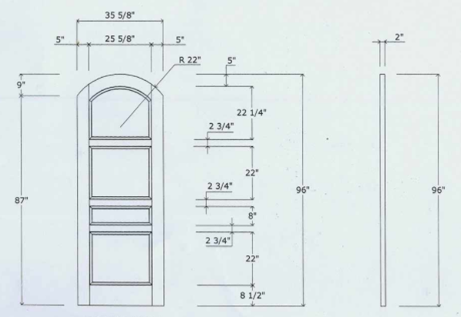
Door Production Manager
DEANSTEEL MANUFACTURING COMPANY
Inventory
Orders
Quote
Users
Report
LOGOUT
Upload Blueprint
Remove Blueprint
Add Notes
Save
Blueprint - User clicks on “Add Blueprint” link from Quotes List or “Blueprint” button from Quote Summary page to enter Blueprint page.

Slide 9
Door Production Manager
DEANSTEEL MANUFACTURING COMPANY
Inventory
Orders
Quote
Users
Report
LOGOUT
Print
Quote Summary Report - Order 0570
Customer: Philly Cheese Inc.
Number: (210) 394-2199
Email: phil02@cheese.com
Order ID: 0570
Date Placed: 9/12/2017 2:40pm
Qty Part Price
1 Generic_Door01 US $399.99
1 Generic_Door_Frame03 US $99.99
2 Generic_Door_Lock02 US $29.99
3 Generic_Door05 US $799.99
3 Generic_Door_Lock10 US $99.99
TOTAL: US $6199.68
Export
Report Page - User clicks Report on tab, opens a Report page depending on current open tab. This is an example of a Quote report.

